Slide 1
Neural Networks and Deep Learning
Sigal Shaked

Slide 2
So, what is deep learning?

Slide 3
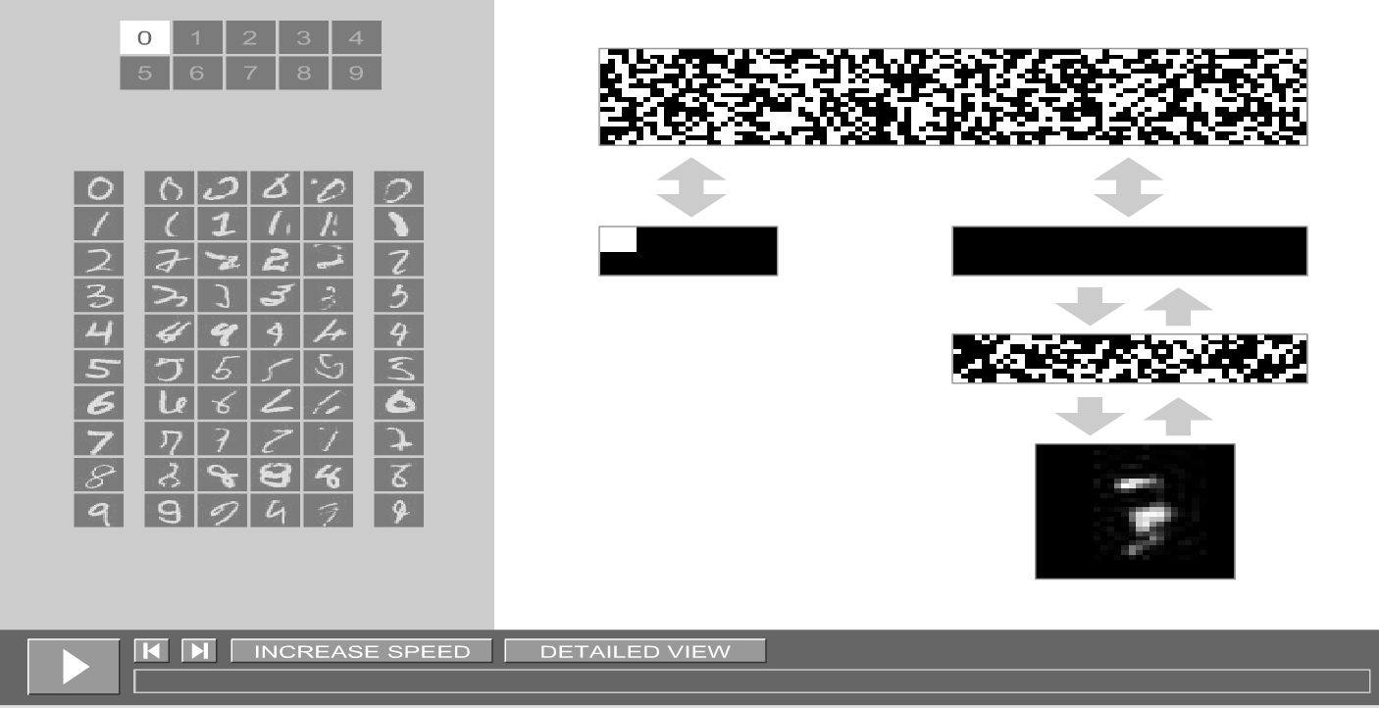
Watch the magic.. Hinton's Neural Network Simulation
http://www.cs.toronto.edu/~hinton/adi/
More demos

Slide 4
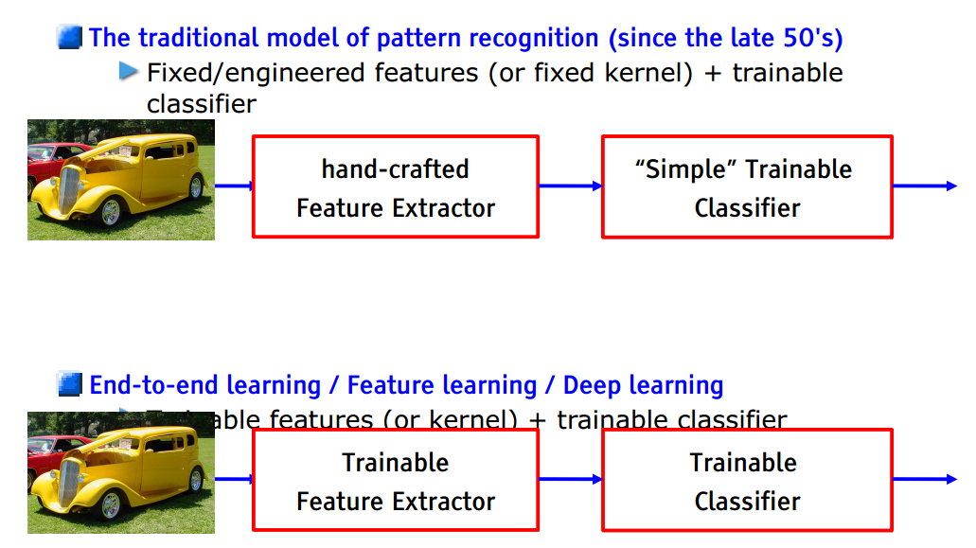
How is it different from other approaches?
Notes:
With most machine learning, the hard part is identifying the features in the raw input data
Deep learning removes that manual step, instead relying on the training process to discover the most useful patterns across the input examples.
Neural networks are more general than most other machine-learning techniques. The same underlying techniques for architecting and training networks are useful across all kinds of natural data, from audio to seismic sensors or natural language. No other approach is nearly as flexible.

Slide 5
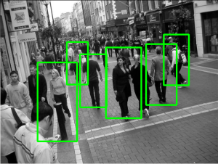
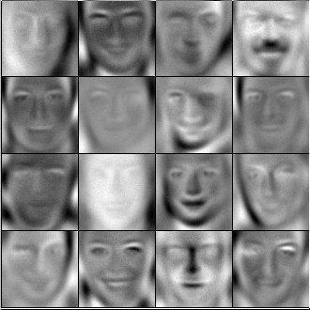
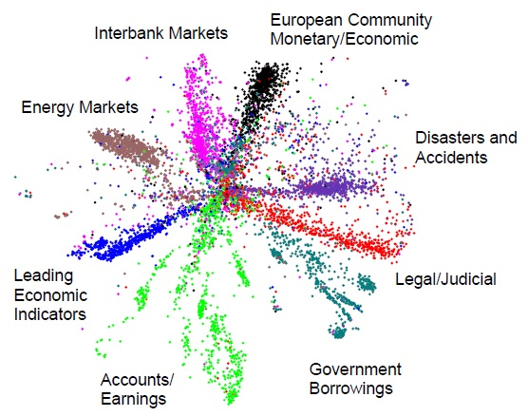
How is it different from other approaches?
Neural networks are more general than most other machine-learning techniques.
The same underlying techniques for architecting and training networks are useful across all kinds of natural data, from audio to seismic sensors or natural language. No other approach is nearly as flexible.
https://www.oreilly.com/ideas/what-is-deep-learning
Notes:
With most machine learning, the hard part is identifying the features in the raw input data
Deep learning removes that manual step, instead relying on the training process to discover the most useful patterns across the input examples.
Neural networks are more general than most other machine-learning techniques. The same underlying techniques for architecting and training networks are useful across all kinds of natural data, from audio to seismic sensors or natural language. No other approach is nearly as flexible.

Slide 6
Why should you dig in deeper?
The bottom line is that deep learning works really well, and if you ever deal with messy data from the real world, it’s going to be an essential element in your toolbox over the next few years.
Until recently, it’s been an obscure and daunting area to learn about, but its success has brought a lot of great resources and projects that make it easier than ever to get started.
https://www.oreilly.com/ideas/what-is-deep-learning

Slide 7
Let’s go over the basics
Neural Networks

Slide 8
Artificial Neuron Model
-1
x₁
x₂
x₃
x_{m}
b_{i} :Bias
w_{i1}
Σ
f
a_{i}
Neuron^{i} Activation
w_{im}
function
Input Synaptic Output
Weights

Slide 9
Artificial Neuron Model
Neuron_{i} computes its activation level a_{i}:
_{n}
a_{i} = f (n_{i}) = f (Σw_{ij}x_{j})
^{i = 0}
where f is one of the several possible activation functions.

Slide 10
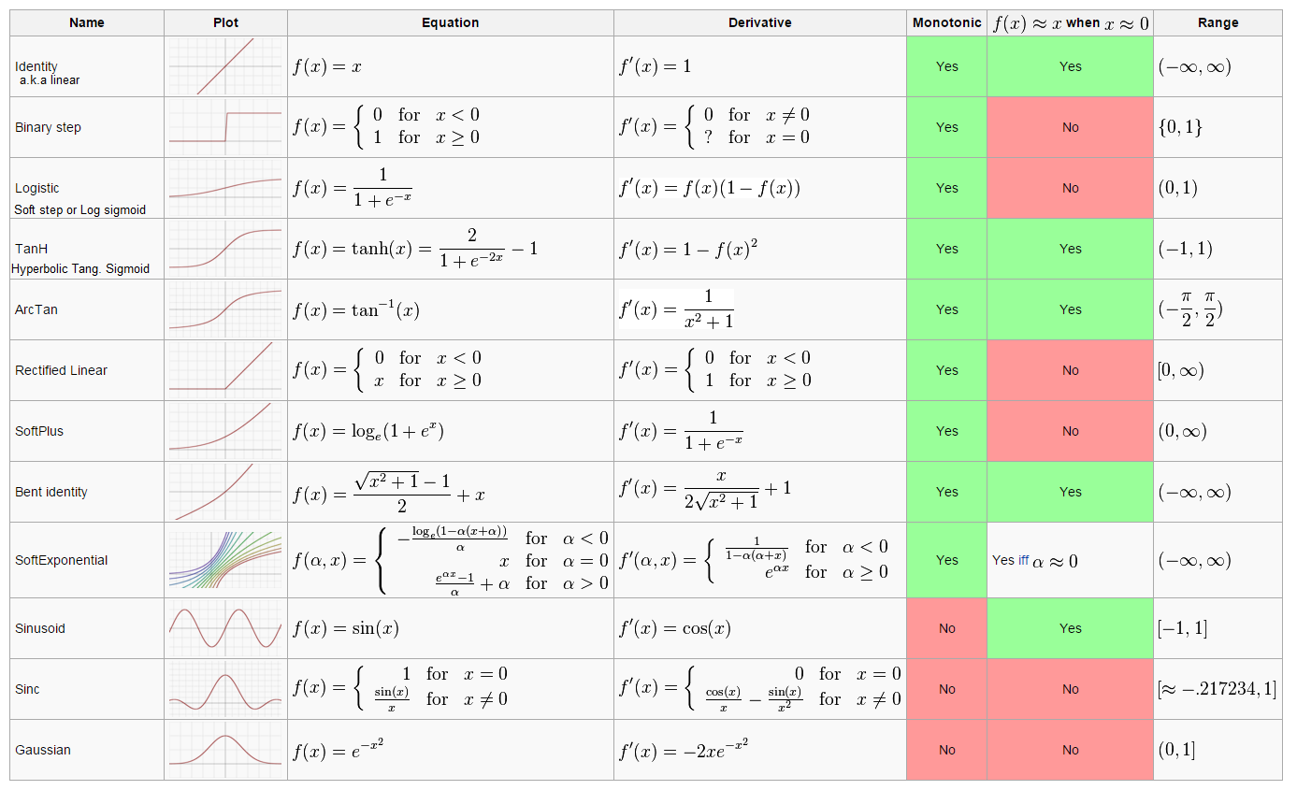
Activation Functions
The list is taken from Wikipedia
A more detailed list can be found in: http://stats.stackexchange.com/questions/115258/comprehensive-list-of-activation-functions-in-neural-networks-with-pros-cons

Slide 11
Artificial Neural Network Training Procedure
The process of determining the values for W on the basis of the data is called training or learning
The Training Here is like any Non-Linear Regression!!!
Notes:
Add slide about batch and non batch training – mention “epoch”

Slide 12
What’s all this got to do with Neural Nets, then, eh??
For supervised learning, neural nets are also models with vectors of w parameters in them. They are now called weights.
As in regression, we want to compute the weights to minimize sum-of-squared residuals.
We use GRADIENT DESCENT to SEARCH for the weights.
Notes:
Instead of explicitly solving for max. likelihood weights, we use GRADIENT DESCENT to SEARCH for them.

Slide 13
Artificial Neural Network multilayer perceptron
Neurons
Weights
Hidden Layer
Output Layer
Inputs

Slide 14
Multilayer Networks
The class of functions representable by perceptrons is limited
Use a wider representation !
This is a nonlinear function
Of a linear combination
Of non linear functions
Of linear combinations of inputs

Slide 15
Neural Network Model
Inputs
Output
Age
34
.6
.4
.2
Σ
0.6
.1
.5
Gender
2
Σ
.3
.2
.8
.7
Σ
“Probability of beingAlive”
Stage
4
.2
Dependent variable
Prediction
Independent variables
Weights
HiddenLayer
Weights

Slide 16
Optimization
Backpropagation allowed us to measure how each weight in the network contributed to the overall error.
This ultimately allows us to change these weights using a different algorithm, Gradient Descent.
Backpropagation doesn't optimize! It moves the error information from the end of the network to all the weights inside the network.
A different algorithm can optimize those weights to fit our data.

Slide 17
Optimization
We actually have a plethora of different nonlinear optimization methods that we could use with backpropagation.
We will walk through Gradient Descent, which is the simplest and most widely used neural network optimization algorithm.
A Few Optimization Methods: • Annealing • Stochastic Gradient Descent • AW-SGD • Momentum (SGD) • Nesterov Momentum (SGD) • AdaGrad • AdaDelta • ADAM • BFGS • LBFGS Visualizing the Difference: • ConvNet.js • RobertsDionne

Slide 18
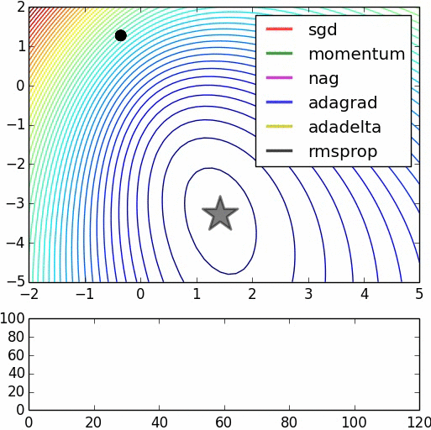
Comparison of a few optimization methods (animation by Alec Radford)
The star denotes the global minimum on the error surface.
Notice that stochastic gradient descent (SGD) without momentum is the slowest method to converge in this example.

Slide 19
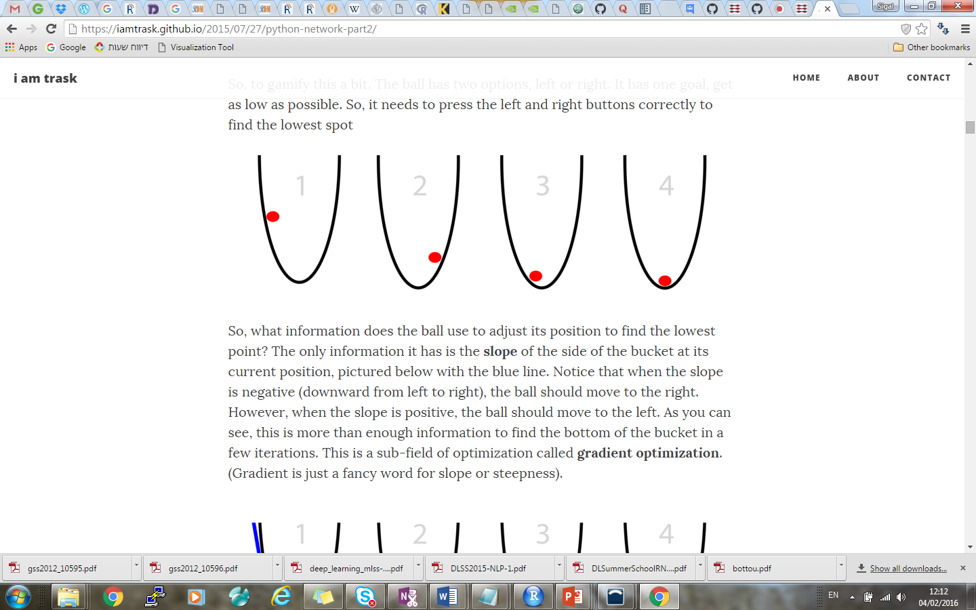
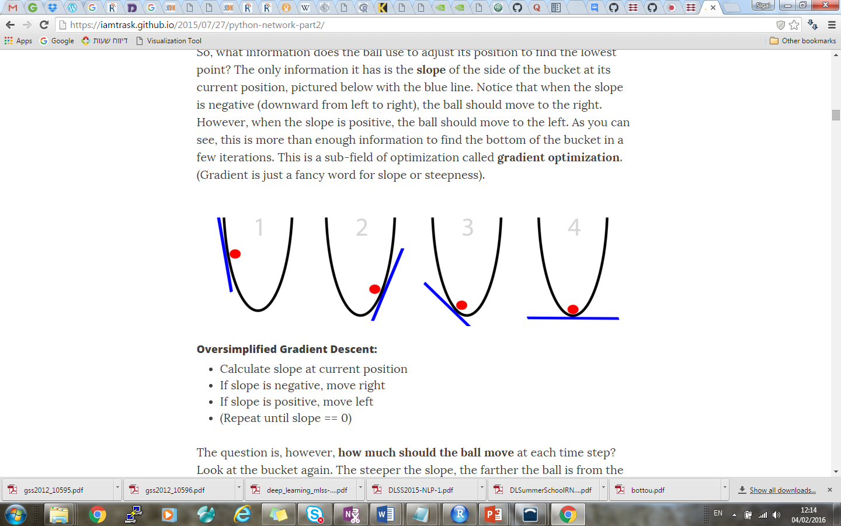
Gradient Descent
Imagine further that the red ball is trying to find the bottom of the bucket. This is optimization.
Notice that when the slope is negative, the ball should move to the right. When the slope is positive, the ball should move to the left. This is a sub-field of optimization called gradient optimization. (Gradient = slope).
-
+
-
How much should the ball move at each time step? The steeper the slope, the farther the ball is from the bottom.
Naive Gradient Descent:
Calculate "slope" at current "x" position
Change x by the negative of the slope. (x = x - slope)
(Repeat until slope == 0 (convergence))
https://iamtrask.github.io/2015/07/27/python-network-part2/

Slide 20
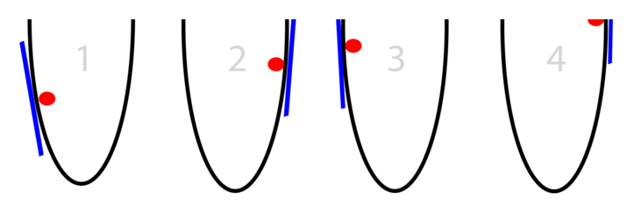
Problem 1: When slopes are too big
Sometimes the slope is so steep that we overshoot by a lot, so that we're even farther away than we started!
Overshooting this far means we land at an EVEN STEEPER slope in the opposite direction. This causes us to overshoot again EVEN FARTHER. This cycle of overshooting is called divergence.
If our gradients are too big, we make them smaller!
We do this by multiplying them (all of them) by a single number between 0 and 1 (alpha, or learning rate)
For example, using: alpha = 0.01
Improved Gradient Descent:
alpha = 0.1 (or some number between 0 and 1)
Calculate "slope" at current "x" position
x = x - (alpha*slope)
(Repeat until slope == 0)
https://iamtrask.github.io/2015/07/27/python-network-part2/

Slide 21
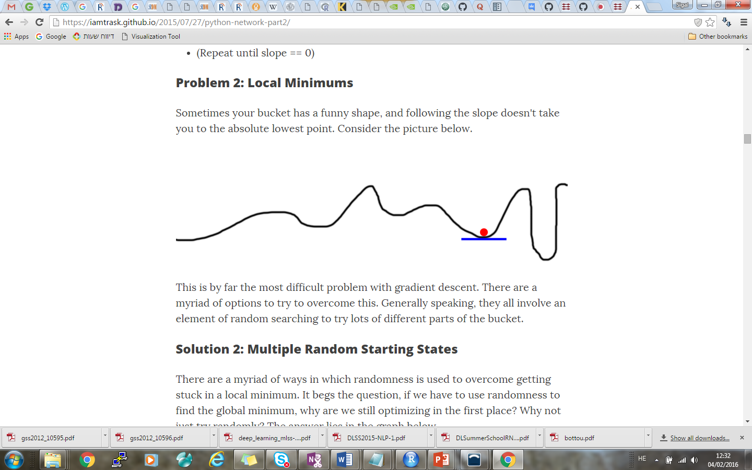
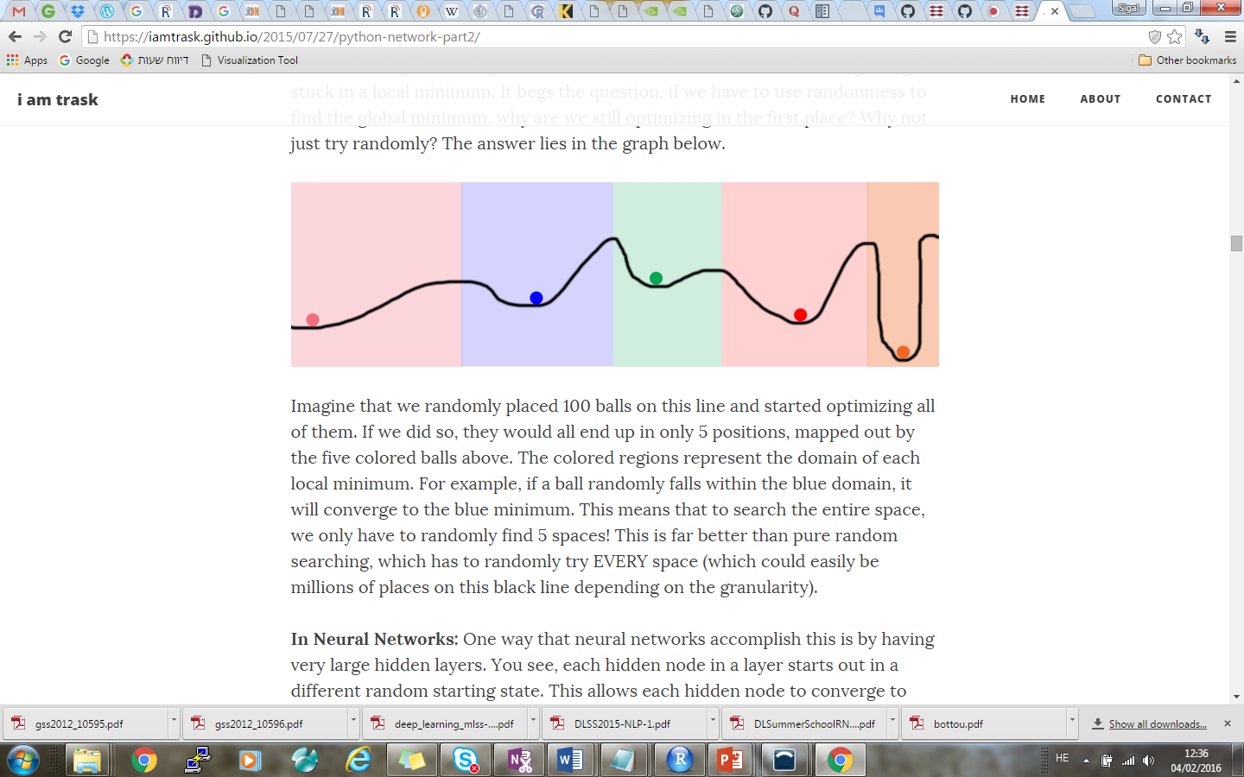
Problem 2: Local Minimums
Sometimes your bucket has a funny shape, and following the slope doesn't take you to the absolute lowest point.
This is the most difficult problem with gradient descent. There are a myriad of options to try to overcome this, they all involve an element of random searching to try lots of different parts of the bucket.
In Neural Networks: Having very large hidden layers may help.
Each hidden node in a layer starts out in a different random starting state.
This allows each hidden node to converge to different patterns in the network.
Parameterizing hidden layers size allows the neural network user to potentially try thousands (or tens of billions) of different local minima in a single neural network.
https://iamtrask.github.io/2015/07/27/python-network-part2/
Notes:
Sidenote: why would we allow a lot of nodes to converge to the same spot? That's actually wasting computational power..; The current state-of-the-art approaches to avoiding hidden nodes coming up with the same answer (by searching the same space) are Dropout and Drop-Connect, which will be covered later.

Slide 22
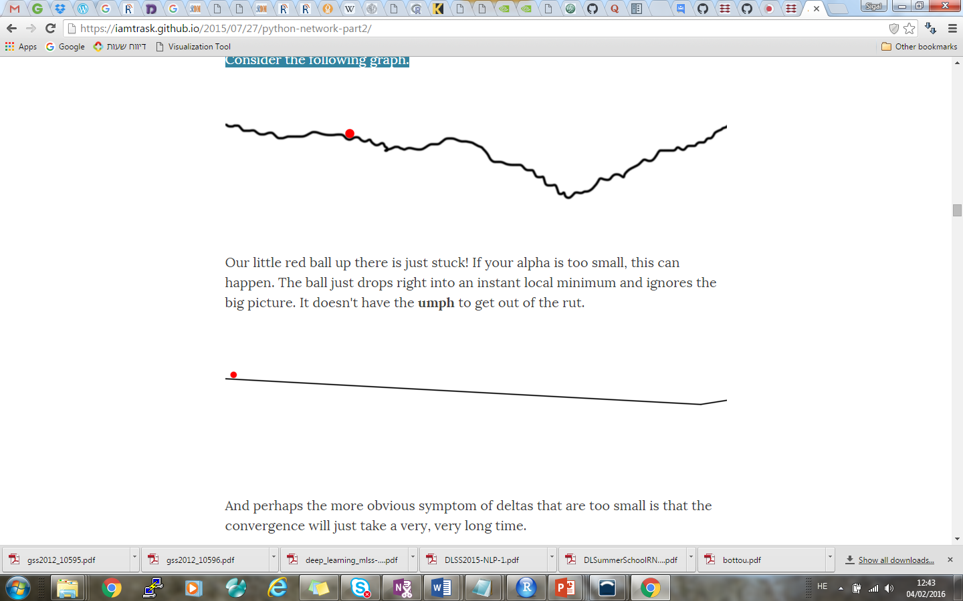
Problem 3: When Slopes are Too Small
Our little red ball up there is just stuck! If your alpha is too small, this can happen. The ball just drops right into an instant local minimum and ignores the big picture.
And perhaps the more obvious symptom of deltas that are too small is that the convergence will just take a very, very long time.
As you might expect, the solution to both of these symptoms is to increase the alpha. We might even multiply our deltas by a weight higher than 1. This is very rare, but it does sometimes happen.
https://iamtrask.github.io/2015/07/27/python-network-part2/

Slide 23
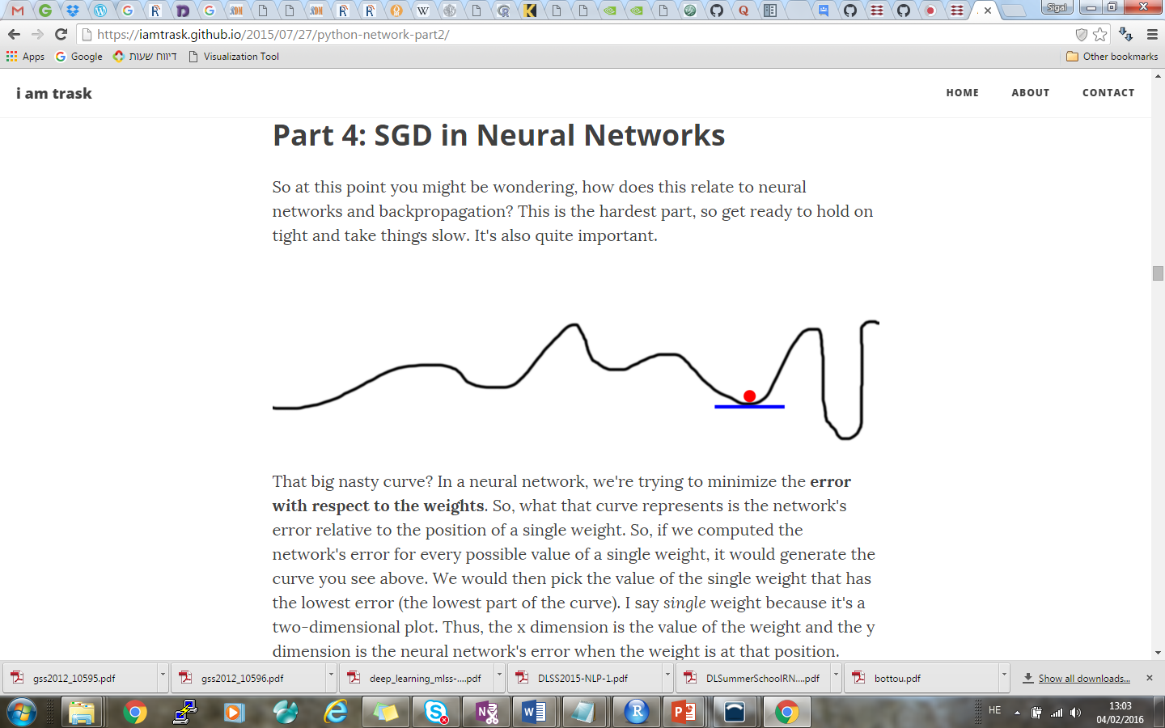
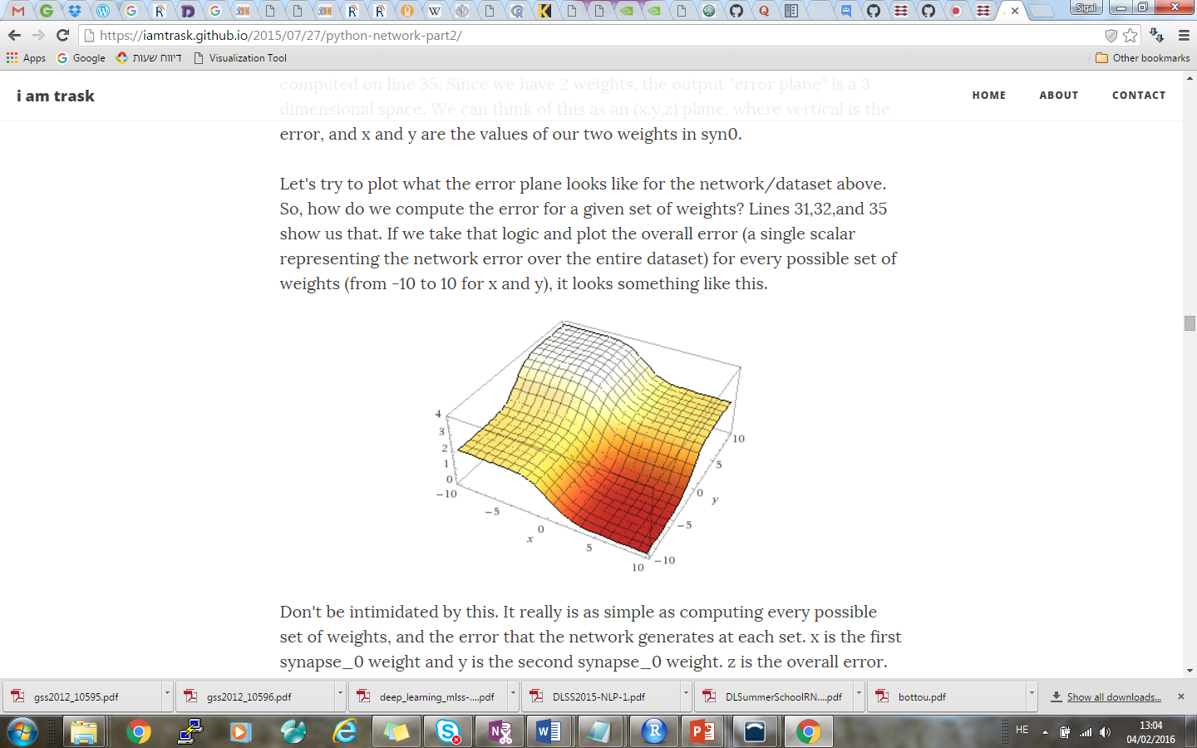
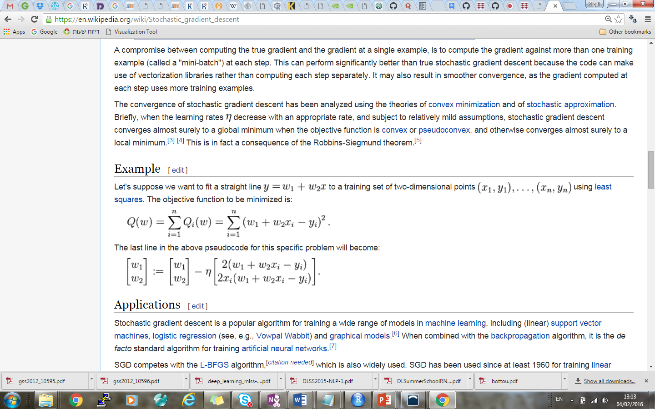
Stochastic Gradient Descent(SGD) in Neural Networks
In a neural network, we're trying to minimize the error with respect to the weights.
The curve represents the network's error relative to the position of a single weight.
error
The network's error for every possible value of a single weight (for a net with two hidden nodes).
w2
w1
We therefore calculate gradient instead of slope, and this is how we update the weights:
( is just another notation for α)
or
https://iamtrask.github.io/2015/07/27/python-network-part2/

Slide 24
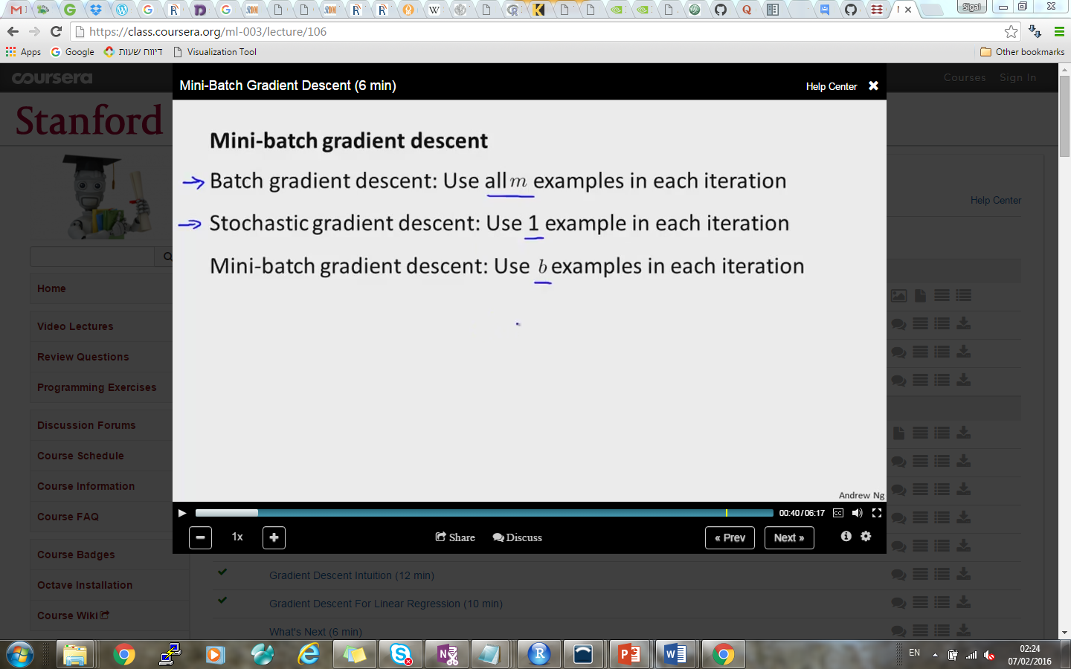
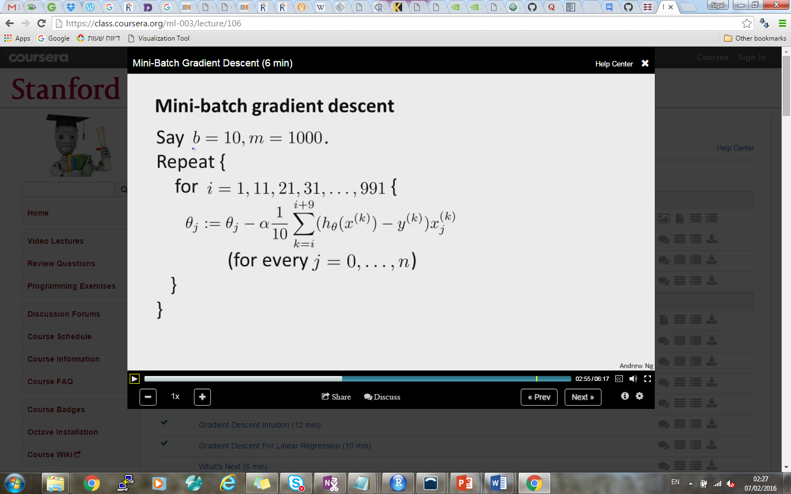
Mini-batch gradient descent
Mini-batch can be performed in parallel and is therefore faster.
10

Slide 25
Recurrent Neural Networks (RNN)

Slide 26
What is Neural Memory?
List the alphabet forward
.... you can do it, yes?
List the alphabet backward
.... hmmm... perhaps a bit tougher.
Try with the lyrics of a song you know?
Why is it easier to recall forward than it is to recall backward?
Can you jump into the middle of the second verse?
... hmm... also difficult. Why?

Slide 27
What is Neural Memory?
There's a very logical reason for this....
You haven't learned the letters of the alphabet or the lyrics of a song like a computer storing them as a set on a hard drive.
You learned them as a sequence. You are really good at indexing from one letter to the next.
It's a kind of conditional memory... you only have it when you very recently had the previous memory.
It's also a lot like a linked list if you're familiar with that.

Slide 28
Recurrent Neural Networks (RNN)
However, it's not that you don't have the song in your memory except when you're singing it.
Instead, when you try to jump straight to the middle of the song, you simply have a hard time finding that representation in your brain
it hasn't tried to look for it this way before
it doesn't have a map to the location of the middle of the second verse.
Some problems are far more efficient if modeled as a sequence with a short term / pseudo conditional memory.
Notes:
It's a lot like living in a neighborhood with lots of coves/cul-de-sacs. It's much easier to picture how to get to someone's house by following all the windy roads because you've done it many times, but knowing exactly where to cut straight across someone's backyard is really difficult. Your brain instead uses the "directions" that it knows... through the neurons at the beginning of a song.

Slide 29

Recurrent Neural Networks (RNN)
Memory matters when your data is a sequence of some kind.
In this example, each data point is a frame of your video.
If you wanted to train a neural network to predict where the ball would be in the next frame, it would be really helpful to know where the ball was in the last frame!
Sequential data like this is why we build recurrent neural networks.
https://www.youtube.com/watch?v=UL0ZOgN2SqY&feature=youtu.be

Slide 30
Recurrent Neural Networks (RNN)
So, how does a neural network remember what it saw in previous time steps?
Neural networks have hidden layers.
Normally, the state of your hidden layer is based ONLY on your input data.
input -> hidden -> output
Memory changes this.
Memory means that the hidden layer is a combination of your input data at the current timestep and the hidden layer of the previous timestep.
(input + prev_hidden) -> hidden -> output

Slide 31
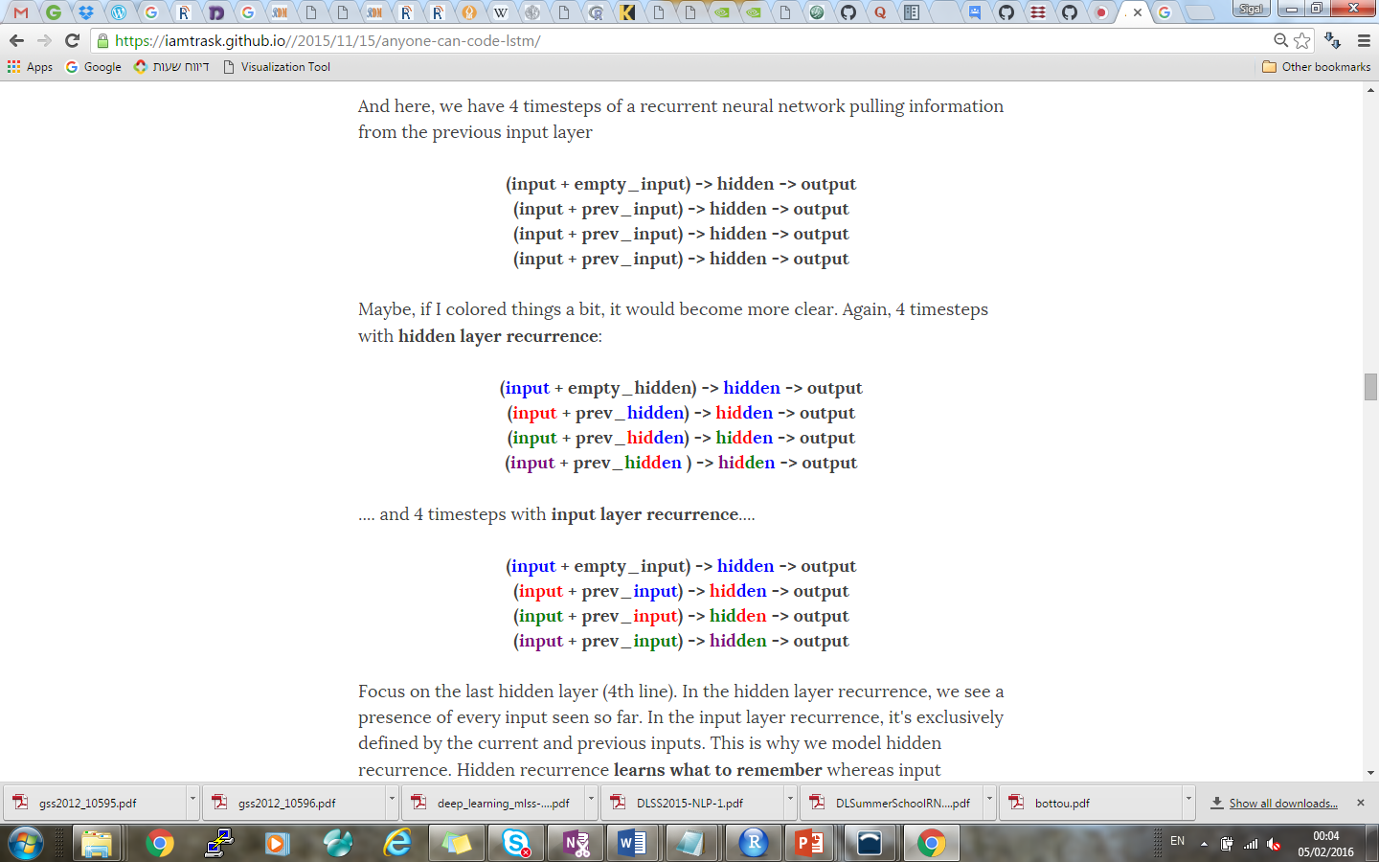
Recurrent Neural Networks (RNN)
Why the hidden layer? Well, we could technically do this.
(input + prev_input) -> hidden -> output
However, we'd be missing out. See for example the following four iterations:
(input + prev_hidden) -> hidden -> output
(input + prev_input) -> hidden -> output
In the hidden layer recurrence, we see a presence of every input seen so far.
Hidden recurrence learns what to remember whereas input recurrence is hard wired to just remember the immediately previous datapoint.

Slide 32
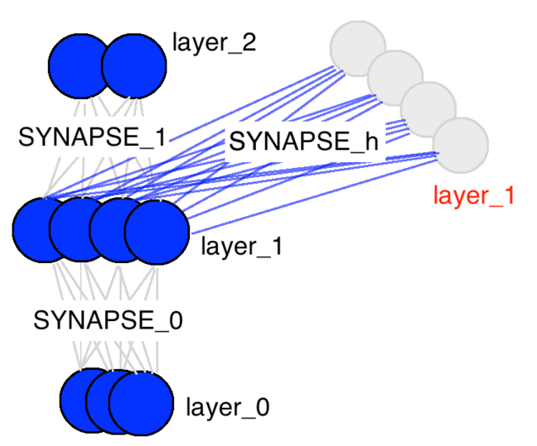
RNN - Neural Network Memory
As we just saw, memory means that the hidden layer is a combination of the input data and the previous hidden layer.
There are only three weight matrices.
The new matrix (SYNAPSE_h, the recurrent one), propagates from the hidden layer (layer_1) to the hidden layer at the next timestep (still layer_1).
SYNAPSE_1: propagates the hidden layer to the output data
SYNAPSE_h:
This matrix defines the relationship between the previous hidden layer and the current one.
SYNAPSE_0: propagates the input data to the hidden layer.

Slide 33
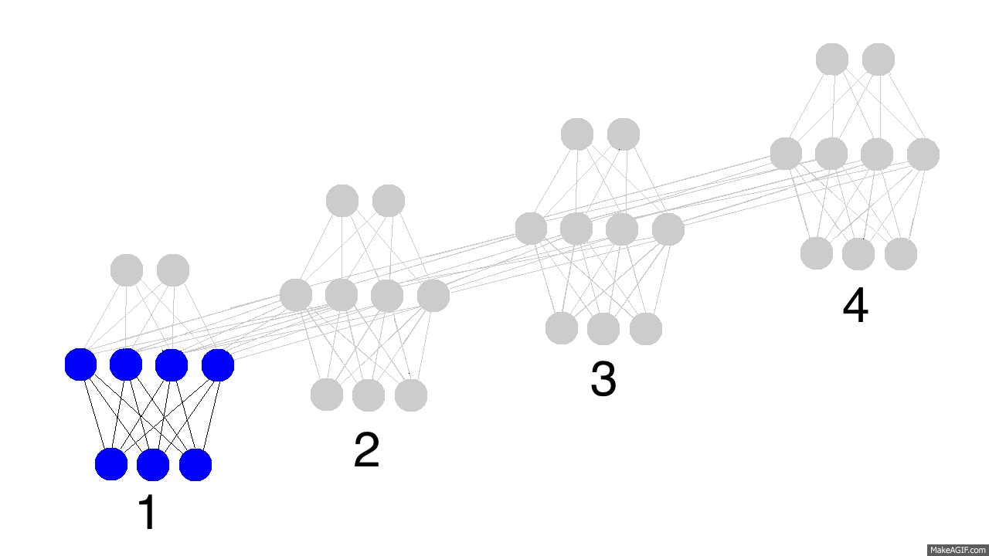
RNN - Neural Network Memory
So, how do recurrent neural networks learn? Check out this animation. Black is the prediction, errors are bright yellow, derivatives are mustard colored.
They learn by fully propagating forward from 1 to 4 (through an entire sequence of arbitrary length), and then backpropagating all the derivatives from 4 back to 1.
Notes:
You can also pretend that it's just a funny shaped normal neural network, except that we're re-using the same weights (synapses 0,1,and h) in their respective places. Other than that, it's normal backpropagation.

Slide 34
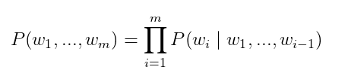
Build a Language Model using a Recurrent Neural Network
Let’s say we have sentence of m words. A language model allows us to predict the probability of observing the sentence (in a given dataset) as:
In words, the probability of a sentence is the product of probabilities of each word given the words that came before it. So, the probability of the sentence “He went to buy some chocolate” would be the probability of “chocolate” given “He went to buy some”, multiplied by the probability of “some” given “He went to buy”, and so on.
http://www.wildml.com/2015/09/recurrent-neural-networks-tutorial-part-2-implementing-a-language-model-rnn-with-python-numpy-and-theano/

Slide 35
Building a Language Model using a Recurrent Neural Network
Why is that useful? Why would we want to assign a probability to observing a sentence?
A scoring mechanism
For example, a Machine Translation system typically generates multiple candidates for an input sentence.
You could use a language model to pick the most probable sentence.
The most probable sentence is likely to be grammatically correct.
Similar scoring happens in speech recognition systems.
A generative model
Given an existing sequence of words we sample a next word from the predicted probabilities, and repeat the process until we have a full sentence.
http://www.wildml.com/2015/09/recurrent-neural-networks-tutorial-part-2-implementing-a-language-model-rnn-with-python-numpy-and-theano/
Notes:
Note that in the above equation the probability of each word is conditioned on allprevious words. In practice, many models have a hard time representing such long-term dependencies due to computational or memory constraints. They are typically limited to looking at only a few of the previous words. RNNs can, in theory, capture such long-term dependencies, but in practice it’s a bit more complex.

